Slide 1


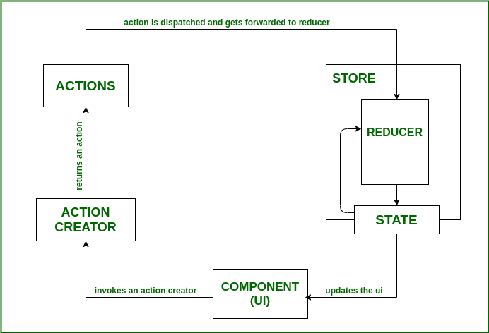
Rajarambapu Institute of Technology, Rajaramnagar
Quantum 2k23
In association with Bharat Forge
Project Title:
Objectives
Technical Specifications & Analysis
Evaluate encryption methods (IBE, ABE, homomorphic, searchable) for enhancing cloud storage security.
Examine the integration of a load balancer with GitHub for optimized data distribution and storage.
Explore post-quantum encryption for fortified cloud storage security against emerging threats.
Assess practical implications of diverse encryption measures in real-world cloud storage scenarios.
Identify evolving security needs and research adaptive encryption methods for cloud storage.
Implement Identity-Based Encryption (IBE), Attribute-Based Encryption (ABE), Homomorphic Encryption, and Searchable Encryption.
Strategically integrate a load balancer with GitHub for optimized data distribution.
Assess the impact of encryption methodologies on cloud storage performance.
Propose adaptive encryption methods aligned with identified security needs for ongoing protection.
Group Members :
1) Harshal P Gavali
2) Adharva kumar H Thodupunooru
3) Gourav T Powar
4) Rohan D Chicnchkar
Name of Supervisor : Prof. Dipali Ghadage
Background
Results and Conclusions
Methodology & Project Diagram
In conclusion, the research from the represents a significant stride in fortifying data security in dynamic cloud storage. The incorporation of advanced encryption methodologies such as identity-based, attribute-based, homomorphic, and searchable encryption demonstrates a comprehensive approach to safeguarding user data. The strategic integration of a load balancer with GitHub underscores the innovative nature of the study, optimizing resource utilization through multiple repositories. Notably, the research's foresight in addressing emerging threats, particularly through post-quantum encryption, highlights its commitment to staying ahead of the evolving security landscape in cloud storage. This study lays a foundation for enhanced data protection and privacy, setting a benchmark for future advancements in cloud security.
In the era of dynamic cloud storage, the imperative of safeguarding user data has intensified, prompting an in-depth exploration into advanced encryption methodologies. Employing cutting-edge technologies like identity-based encryption, attribute-based encryption, homomorphic encryption, and searchable encryption, the study not only fortifies cloud environments but introduces a pioneering data management approach. The strategic integration of a load balancer with GitHub, optimizing resource utilization through multiple repositories, showcases a distinctive feature. Furthermore, the research anticipates and addresses emerging threats with a focus on post-quantum encryption, emphasizing the continuous evolution of data encryption technologies to meet the dynamic security landscape of cloud storage.
The methodology for crafting an advanced and secure cloud storage platform adopts a systematic approach. Prioritizing security in the face of escalating
data demands, the project aims to mitigate challenges like unauthorized access and data breaches. Utilizing technologies such as GitHub, Firebase, HTML,CSS, and JavaScript, the endeavor is to establish a freely accessible platform. Beyond addressing fundamental file operations like upload, deletion, and download, the project aspires to redefine accessibility and safety through innovative technological integration, meeting the evolving needs of data generation and storage in a robust and secure manner.
Problem Statement:
Applications
Develop a high storage cloud platform that provides enhanced security measures to protect
user data while maintaining the confidentiality, integrity, and availability of their data.
Applications:
1. Secure Cloud Storage Services : Utilizing advanced encryption methods enhances user data security, offering a comprehensive solution for protecting sensitive information in the cloud.
2. Enterprise Data Management Systems : Businesses can fortify their data management systems, ensuring the security of proprietary information by adopting the researched encryption technologies, along with optimizing resource utilization through a load balancer and GitHub integration.
3. 3. Next-Generation Cloud Security Solutions: The research contributes to the development of forward-looking cloud security solutions, proactively addressing emerging threats with a focus on post-quantum encryption, providing a versatile and adaptable framework for securing diverse cloud environments.

